Slide 1


CSE424 (Pattern Recognition)
RESEARCH PAPER PRESENTATION
Faiyaz Bin Yousuf
ID-22101845

Slide 2
Table Of Contents
01
Summary
1.1
Motivation
1.2
Contribution
1.3
Methodology
1.4
Conclusion
02
Limitations
03
Synthesis

Slide 3

A Brief Summary of the Paper
Research Paper Information
TITLE:
Look at the Driver, Look at the Road: No Distraction! No Accident!
AUTHORS:
Mahdi Rezaei and Reinhard Klette
The University of Auckland
Summary
AI prevents rear-end crashes in real-time by monitoring drivers and road conditions.
Uses computer vision to track behavior and identify potential hazards.
Overcomes challenges like variable lighting for reliable detection.
Processes data at 21 frames per second for efficient analysis.
Reduces accidents caused by driver distraction or fatigue.

Slide 4
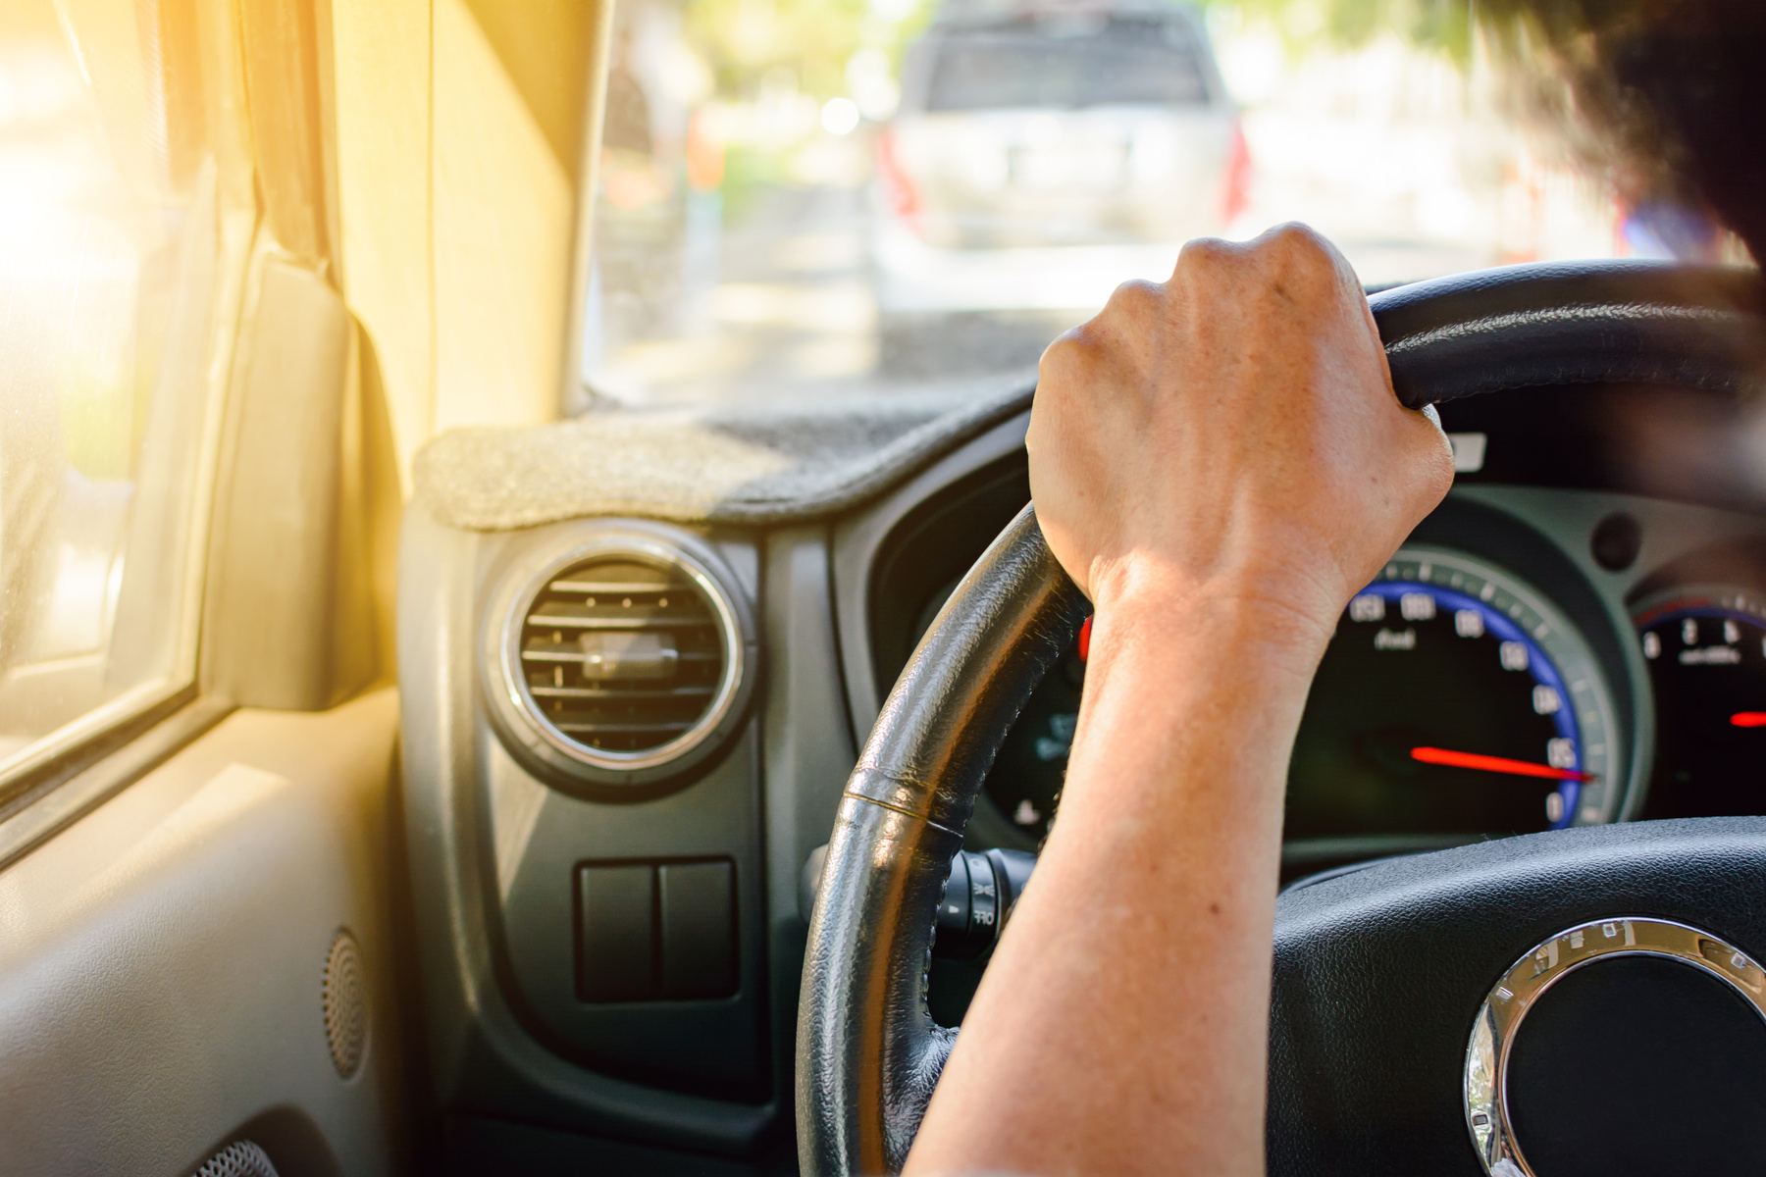
1.1 Motivation
Rising Concerns in Road Safety
Behavioral Causes of Accidents
Existing Safety Systems and Their Limitations
Public Awareness

Slide 5


1.2 Contributions
Innovative Techniques: Asymmetric Appearance Modeling (ASAM)
Advanced Driver Assistance Systems (ADAS) Integration
Fuzzy Fusion System for Risk Assessment.
Accurate Distance Estimation via Fermat-point Transform.
Proactive Driver Assistance

Slide 6
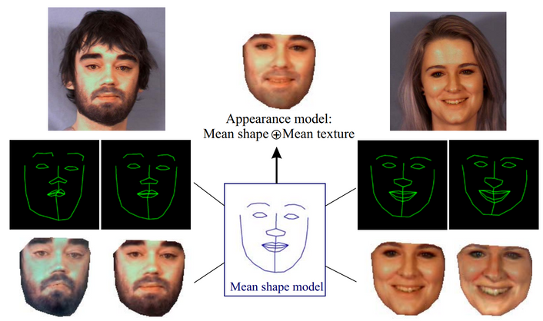
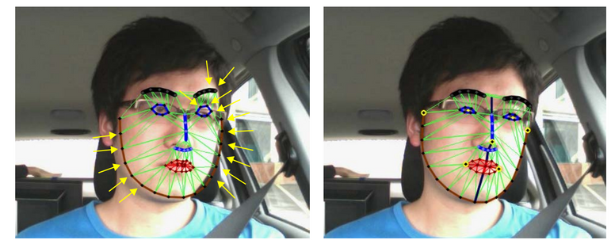
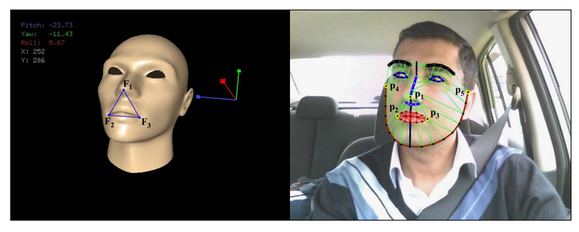
1.3 Methodology
Asymmetric Appearance Modelling (ASAAM)
ASAAM combines face shape and texture via PCA.
Mitigates errors due to lighting variations.
Global Haar classifier ensures rapid model adaptation.
Rapidly refines models, especially in asymmetric contexts.
Aids precise head pose estimation and gaze analysis
Fermat-point Transform
Pose estimation calculates face orientation.
Statistical insights guide initial pose approximations.
EPnP algorithm refines point errors for accurate pose.
Point alignment optimizes facial point matching.
Uniform Fermat-transform ensures consistent model-face match.
ASAAM method leading to a proper model matching both halves of the face
Face Registration by Fermat-transform

Slide 7
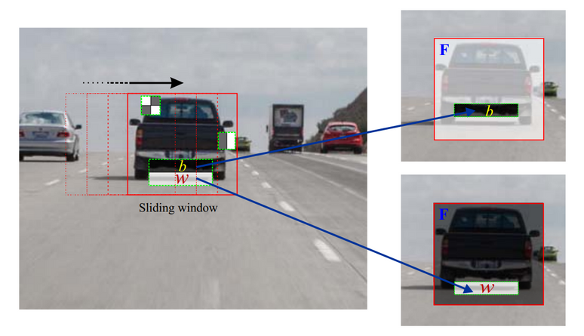
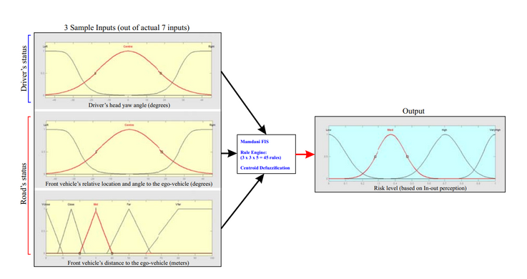
1.3 Methodology (Continued)
GHaar Classifiers for Vehicle Detection
Vehicle detection in dynamic road environments.
GHaar model enhances vehicle classification.
Employs global Haar-like features for classification.
Utilizes inverse-perspective mapping for vehicle distance estimation.
Global Haar integrated with local features for improved performance
Comparison of standard Haar-like features and global Haar-features.
Fuzzy Fusion System for Risk Assessment
Fuzzy Inference System (FIS) replicates human decision-making.
It integrates seven driver-road data inputs.
Based on linguistic expressions and if-then rules, it assesses risk.
The system utilizes fuzzy logic to interpret complex driving scenarios.
As depicted in the Figure, it employs a decision-level fusion structure.
Three sample fuzzy inputs (yaw, distance, and angle), 11 fuzzy membership functions, Mamdani rule-engine, and 4 risk levels as the output of the proposed FIS.

Slide 8

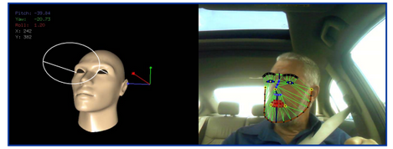
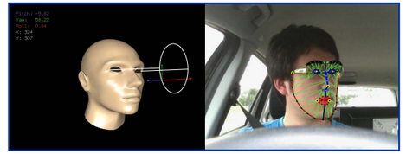
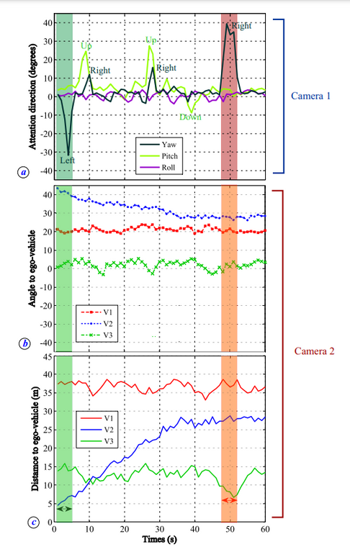
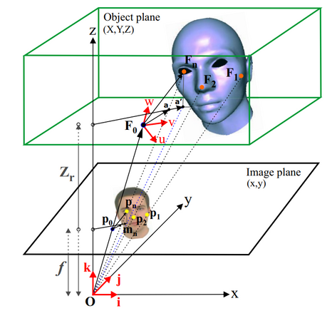
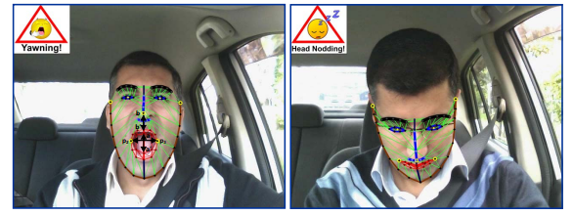
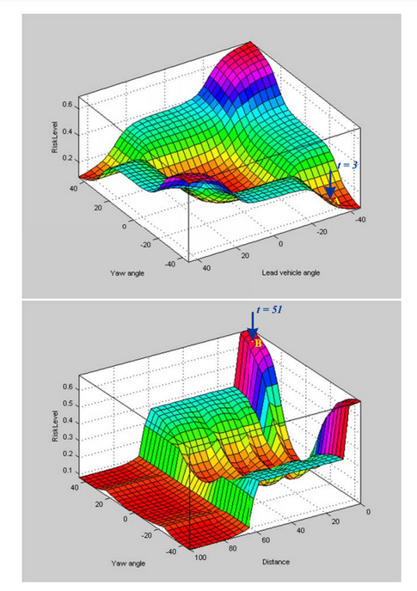
Experimental Results
Pose Estimation
Yawning and Head-nodding Detection
Projection of a 3D face model M into the image plane C
Processed data for simultaneous driver and road monitoring: (a) driver’s head pose, (b) detected vehicles’ angle to the ego-vehicle, and (c) detected vehicles’ distance to the ego-vehicle.
Defuzzified surface plot of the risk-level, based on driver’s attention direction and road situation.

Slide 9

Conclusion
Pattern Recognition in Motion: Safeguarding Drivers from Hazards
Enhanced head-pose estimation with model precision.
Swift model refinement for robustness.
Reliable vehicle detection via monocular cameras.
Real-time fuzzy-fusion for crash prevention.
Encouraging experimental outcomes for future study.

Slide 10


2.Limitations
2.1 First Limitation
Dependency on Ideal Lighting Conditions:
Face detection and pose estimation are highly dependent on ideal lighting conditions.
Impact on reliability in real-world scenarios, especially in varied weather or lighting conditions.
Potential decrease in accuracy due to varying lighting conditions, affecting the system's performance.

Slide 11


2.Limitations
2.2 Second Limitation
Computational Complexity:
High computational complexity may hinder real-time applicability.
Possible delays in critical decision-making due to computational processing.
The system might struggle to process information quickly enough for timely responses in certain environments.

Slide 12
Synthesis
Foundational concepts for developing advanced ADAS systems.
Integration of driver and road situation monitoring is crucial for enhancing road safety.
Real-time implementation significantly improves road safety measures.
Advanced techniques aim to reduce accidents on the road.
Serves as groundwork for the future development of autonomous driving systems.

Slide 13
Thank You For Watching!
Special Thanks to Annajiat Alim Rasel Sir

